Slide 1
Publicis Sapient Logo

Slide 2

Road map
Concepts which are covered Till Today
Induction
Java
NodeJS
Soft Skills
Java Capsule project
NodeJs Capsule project
Database
Infrastructure
QE/QC
Confluence & Jira
SDLC
Mini Project

Slide 3

Library Management Signup Page
Veeresh R K

Slide 4
Table of Content
Overview
Software Development life cycle
Implementation of Library sign up page using
Java program
NodeJs program
Complete Mini project
Test cases
Jira
Conclusion

Slide 5

Overview
The program aims to provide users with a user-friendly interface to input and retrieve information related to Student Name, Email Address, Phone Number, Student Roll Number, Father Name, Book Issued Name. This project serves as a foundational exercise in Java programming, NodeJs , SDLC and Testing concepts, focusing on basic user interactions and object-oriented design principles.

Slide 6
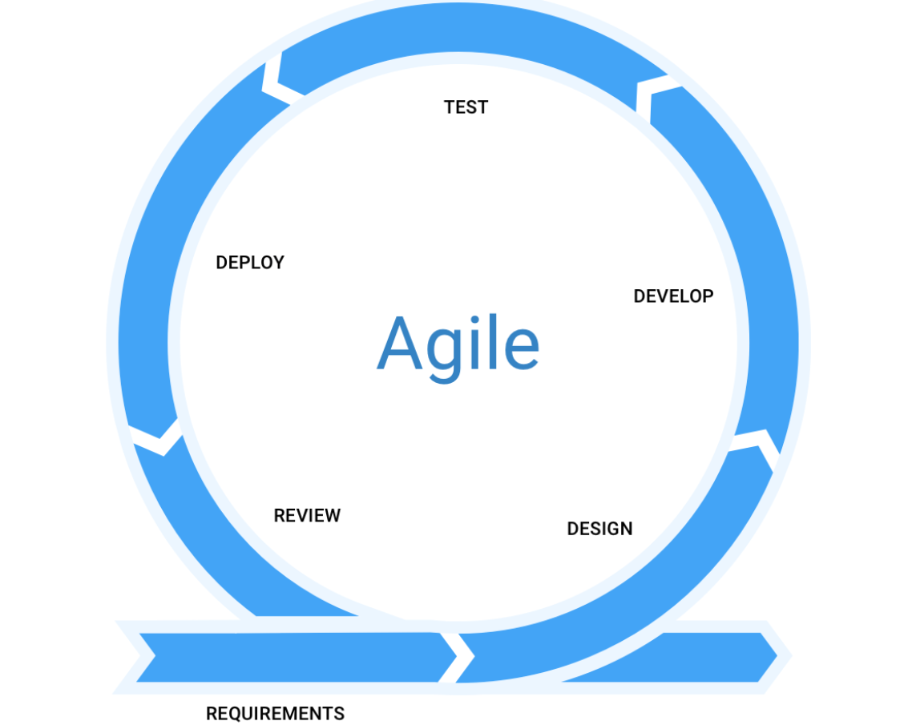
Software Development Life cycle
The Agile Manifesto values are:
Individuals and interactions over processes and tools.
Working software over comprehensive documentation.
Customer collaboration over contract negotiation.
Responding to change over following a plan.

Slide 7
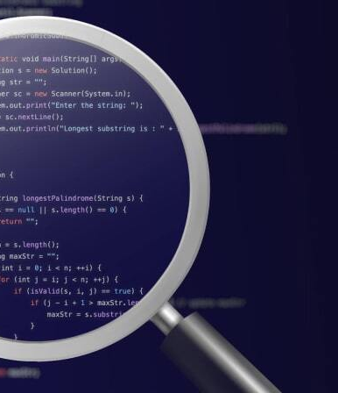
Implementation
Java
The following topics have been covered in this project.
Class
Object
I/O Statement
Conditional statement
Methods
Encapsulation
Exception Handling
Finally
Packages

Slide 8
Code Overview
1. Purpose:Create a Java program for students to sign up in a library system, entering details like name, email, and issued book.
2. Class Structure: Defines a `Student` class with private fields and methods to get and set data securely.
3. Input Validation: Ensures proper data entry by validating inputs, like checking email format and phone number length.
4. Main Class: The `LibrarySignupClass` contains the main program, prompting users to input information.
5. User Interaction: Asks users for their name, email, phone number, roll number, father's name, and issued book.
6. Information Display: Prints out the entered information if it passes validation.
7. Exception Handling: Manages errors by catching and handling `IllegalArgumentException` for invalid inputs.
8. Closing Interaction: Closes the input scanner and displays a message indicating the entered data has been processed.

Slide 9
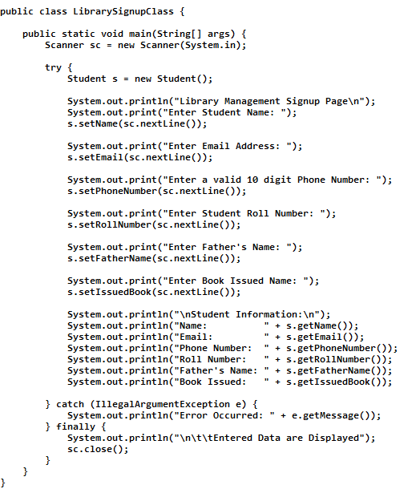
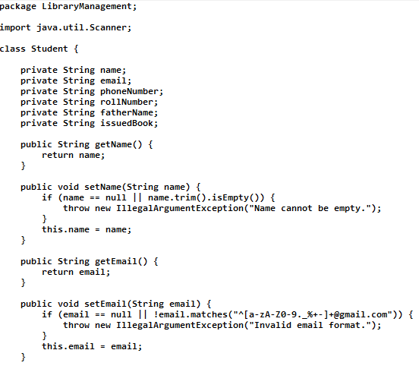
Code
getter and setter is implemented for all other instance variables

Slide 10
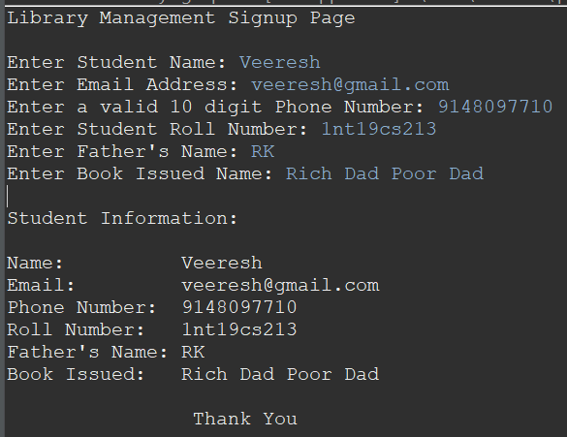
Code Output

Slide 11

Implementation
NodeJS and MongoDB
The following topics have been covered in this project.
ReadLine Module
MongoDB Connection
Asynchronous Programming
Function Definitions
Regular Expressions
While loop
User Input Handling
Validation and Error Handling
Main Function Execution

Slide 12
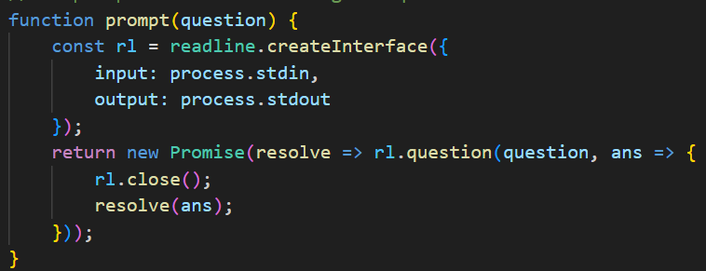
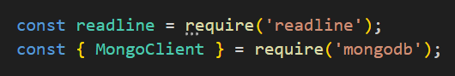
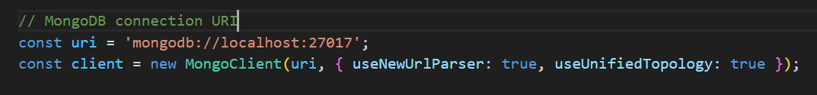
Code Overview
User Interaction Setup:
- Utilizes Node.js's `readline` module for user interaction, prompting the user for various information.
MongoDB Connection Configuration:
- Configures the MongoDB connection using the provided URI and options for connection settings.

Slide 13
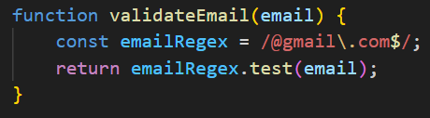
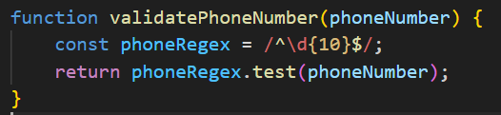
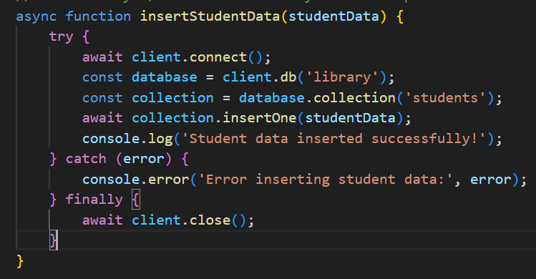
Code Overview
User Input Validation:
- Validates the format of the entered email address and phone number using regular expressions.
Data Insertion Function:
- Defines an asynchronous function to insert student data into MongoDB, handling errors and ensuring proper database connection management.

Slide 14
Code Overview
Signup Process:
- The main function orchestrates the signup process, guiding the user through entering student information, validating it, and inserting it into the database.
Prompting for Information:
- Prompts the user for student name, email address, phone number, roll number, father's name, and book issued name.
Input Validation Loops:
- Continuously prompts the user until valid email and phone number formats are entered.
Error Handling and Execution:
- Initiates the signup process, catches and logs errors if any occur during execution, ensuring smooth user experience and proper data management.

Slide 15
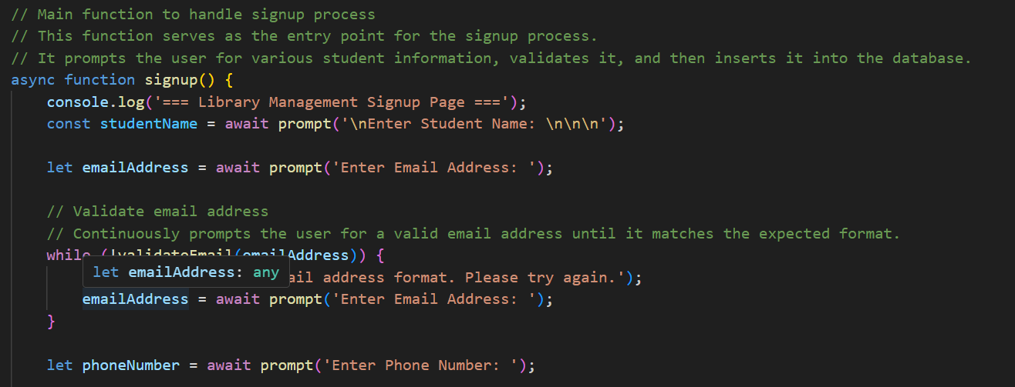
Code
Creating ReadLine interface and validating email

Slide 16
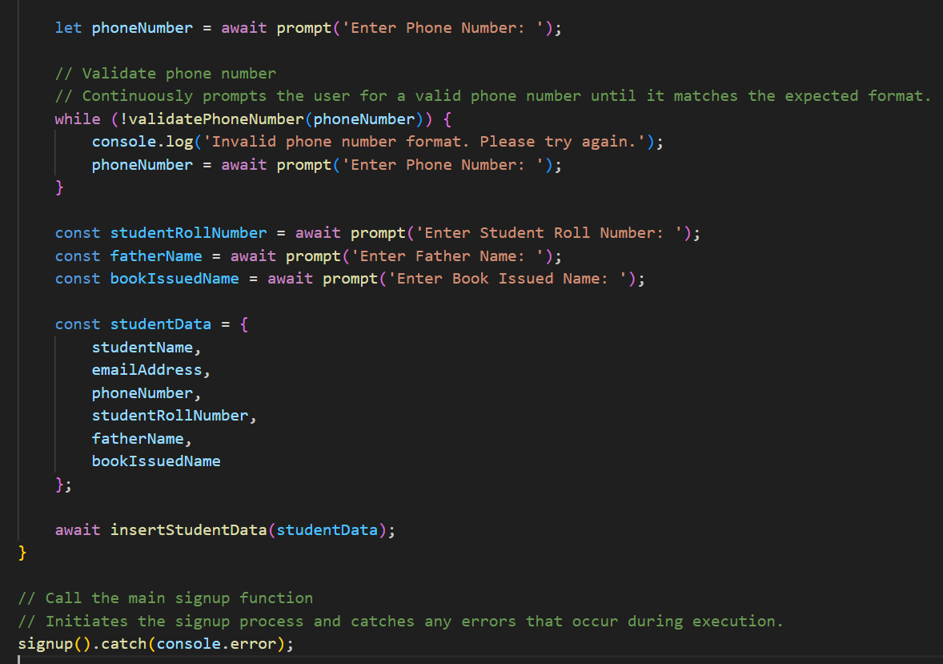
Code
Main Function to get the Student information and Display it in Console

Slide 17
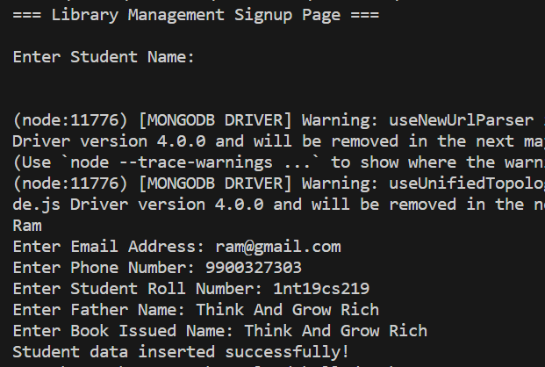
Code Output

Slide 18
Mini-Project

Slide 19
Code Overview
Express.js: A web application framework for Node.js used to build web applications and APIs.
Body Parsing Middleware: Middleware used to parse incoming request bodies in a middleware before handlers.
MongoDB: A NoSQL database used for storing and managing data.
Routing: Express routing to handle different HTTP requests and route them to the appropriate handlers.
Form Submission Handling: Handling form submissions from the client-side to the server.
Data Validation: Ensuring the integrity and validity of user-provided data.
Asynchronous Programming: Using async/await to handle asynchronous operations such as database connections and queries.
Error Handling: Managing errors that might occur during data processing or server operation.
Static File Serving: Serving static files like HTML, CSS, and JavaScript using Express middleware.
Client-Server Interaction: Handling communication between the client (browser) and the server.

Slide 20
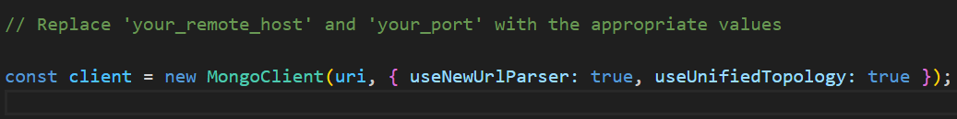
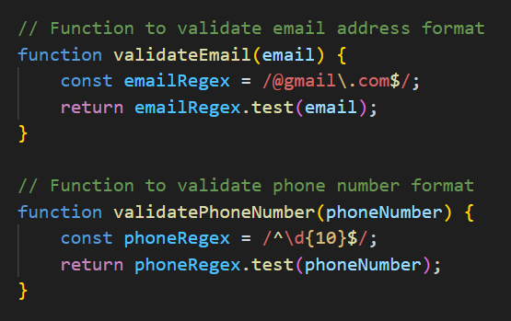
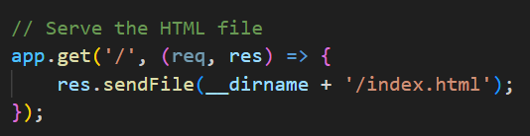
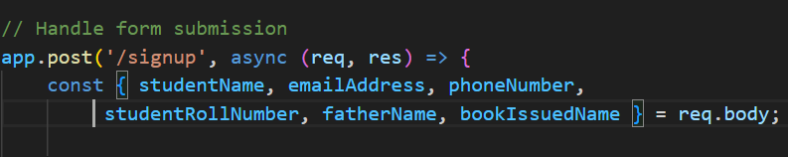
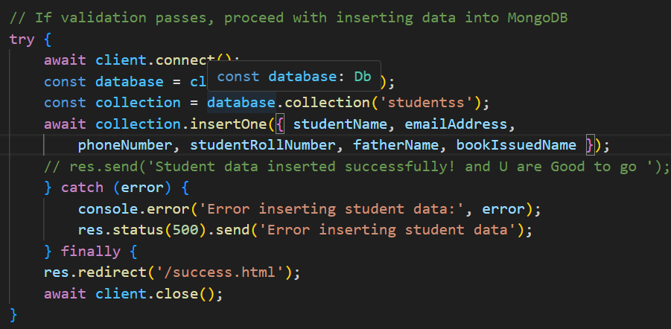
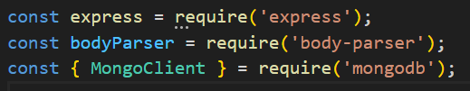
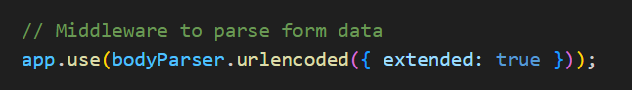
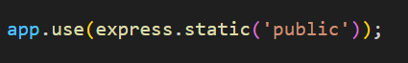
Code Overview
Form Submission Handling
Routing
MongoDB
Body Parsing Middleware:
Express.js
Data Validation
Asynchronous Programming
Error Handling
Static File Serving
Client-Server Interaction Front-end and Backend

Slide 21
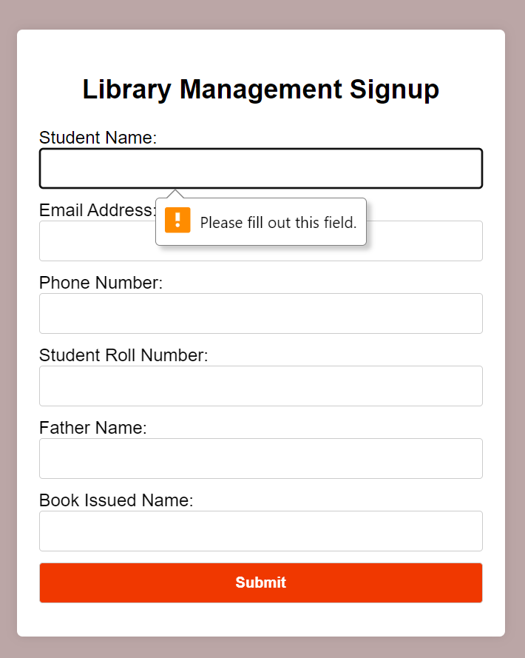
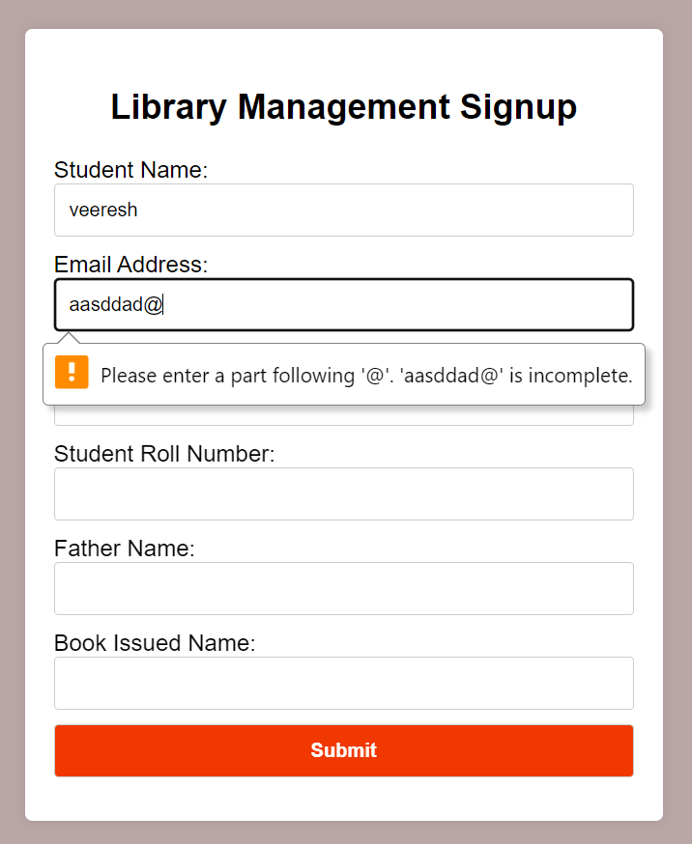
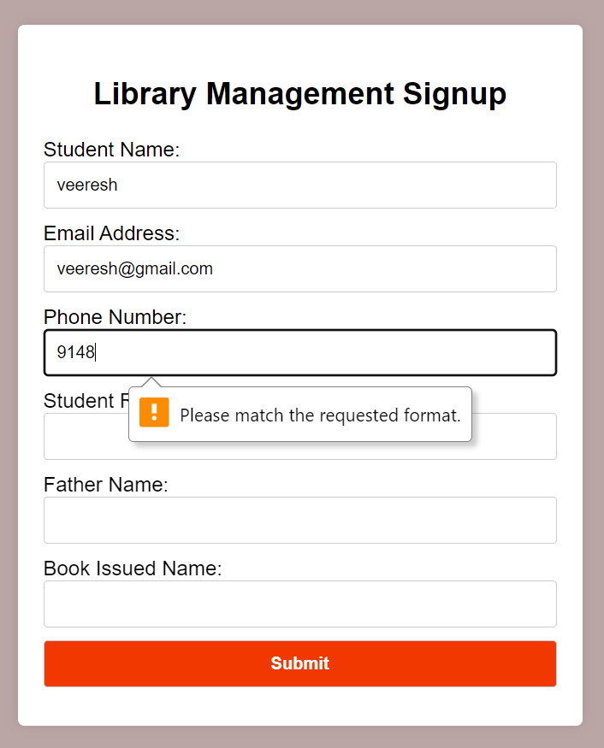
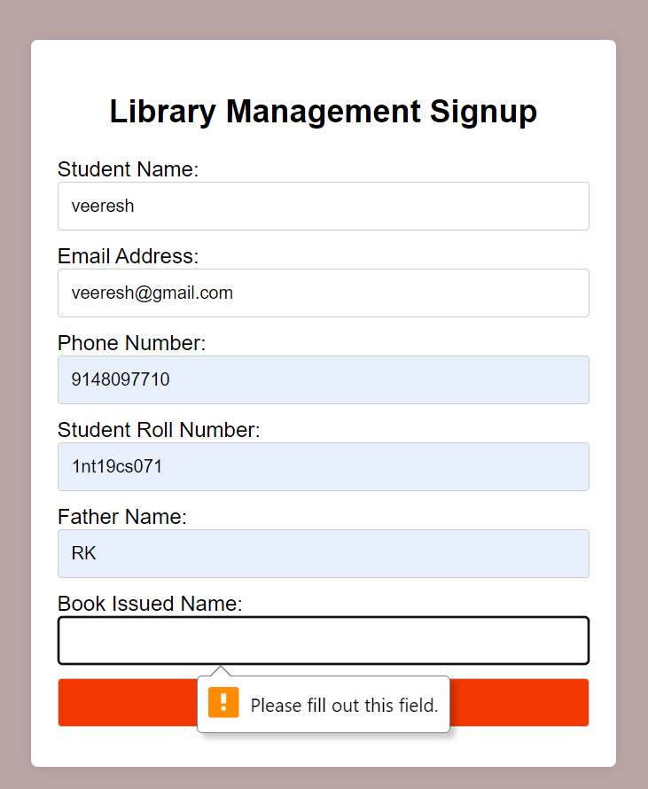
Code Output

Slide 22
Test Case
1. Functional Testing:
- Form Submission
- Redirect to Success Page
- Static File Serving
2. Validation Testing:
- Email Address Validation
- Phone Number Validation
3. Integration Testing:
- MongoDB Connection
- Data Insertion
- Database Closure
4. Usability Testing:
- User Interface
- User Experience
5. Error Handling Testing:
- Validation Errors
- Database Errors
6. Performance Testing:
- Load Testing
- Response Time
7. Compatibility Testing:
- Browser Compatibility
- Device Compatibility

Slide 23
Jira
Task
Database
Student Details
Project
Epic
Story
Task
Library Signup page
Develop a program
NodeJs
Task
Java

Slide 24
Conclusion
Key takeaway
Future scope of this project
This application handles library signup form submissions, validates input, and stores data in MongoDB, demonstrating backend form processing and database integration.
Enhance user experience with frontend validation, implement user authentication, expand database schema for more comprehensive user profiles, and integrate email notifications for signup confirmation.

Slide 25
Thank You

